Slide 1
How much your drinking affect close others?
How his/her drinking affect your life?

Slide 2
Childhood and Families -team
Fragile Childhood: Providing information and direct help&support for ACOAs (e.g. Online councelled peer support groups); Motivating professionals who work with children, young and families; Raising awareness. www.lasinenlapsuus.fi/en
Shadow World: Support & counselling for 12−22 year old COAs (Online councelled peer support groups, chats etc) www.varjomaailma.fi/en
Addiction Link: Online service for substance abusers, their families and friends and all those interested in objective information on substances and addiction; Information, Councelling service, Discussion forum with peer support groups, Online tests, Personalized calendar etc. www.addictionlink.fi
YouthLink: A web site targeted to young people (12−20 year-olds) with themes ranging from substances, gambling, gaming, internet use and depression to bullying. www.nuortenlinkki.fi

Slide 3
Prevalence in Finland
5,5 million inhabitants
330 000 Women (16%)
130 000 Men (6%)
Have experienced severe harms due to family member’s or close-one’s alcohol use in the past year. [1].
From 16-20 year-olds
7 % often
22 % sometimes
experience harms due to parental drinking [2]
[1] National Health and Welfare Institute (2018) Drinking Habit Survey Finland
[2] A-Clinic Foundation population survey (unpublished)

Slide 4
Every fourth Finn has experienced harms due to parental drinking.

Slide 5
In Finland, there are 65 000 – 70 000 children whose at least one parent has a serious substance abuse problem.

Slide 6
How many are getting help & support
?

Slide 7
Target is to make affected Family members & Close others visible in the service system and/or get them help & support in their own right.

Slide 8
2 Interactive tests under development: for Drinker & for Family Member/Close others
Do You think your drinking is excessive?
Does She/He comment your drinking?
Have you ever failed to do something you promised or planned to do, because of the drinking?
Has your family member seen you drunk?
Have you been argueing at the consequence of your drinking?
Have you been hiding your drinking from your family member?
Have you hurt your family member mentally or physically?
Has your family member or someone else asked you to stop or cut down the drinking?
Has your family member been feeling ashamed, being an outsider or less worthy?
Has your family member experienced fatigue, depression anxiety?
Do You think His/Her drinking is excessive?
Do you comment His/Her drinking?
Has He/She failed to do something promised or planned to do because of the drinking?
Etc
Background questions:
Sex: male, female, other, I don’t want to tell Age:
What is your relation to the person in question?
Did you experience harms in your childhood home due to parental drinking?

Slide 9
Next step to go online
AddictionLink has 210 000 visitors monthly
1/3 are family members & close others
Online test are very popular → Data is saved on the server
AUDIT online has been used in AddictionLink 569 416 times (2003 -2016)
Alkohol-E used 1289 times in 2017 → users respond alcohol use is destructive to family.
Through feedback it is possible to provoke thinking and motivate action. →
For Family member: strenghten coping strategies, direct to seek help.
For Drinker: decrease denial, prevent harms to others, motivate for change, direct to seek help.

Slide 10
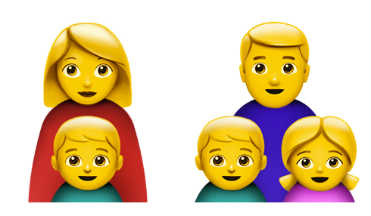
Tools are needed to raise the child and family sensitivity in the substance treatment!
We can understand transgenerational trauma.
Parenthood can be seen as
a resource in the recovery process.
Children and family members are getting attention they need.
Children are included in discussions.
We can elaborate clients’ own childhood

Slide 11
Two main points:
Family members and close others suffering from alcohol abuse are not getting help & support they need, because their situation is not recognized in the service system.
In addition to valid screening tests for alcohol use, there is demand for simple tools and self-help (online) assessments for both practitioners and family members & close others to bring their situation to light.

Slide 12
Thank you!
Minna Ilva
minna.ilva@a-klinikka.fi
www.lasinenlapsuus.fi
www.varjomaailma.fi
Facebook.com/lasinenlapsuus
@lasinenlapsuus #fragilechildhood

